Slide 1

Exploratory Data Analysis (EDA)
Uncovering Stories and Insights Behind Data

Slide 2

The Core Problem — Why EDA Matters?
The Golden Rule
"Garbage In, Garbage Out." — the quality of your output is only as good as your input data.
The Reality of Raw Data
Raw data is messy, incomplete, and full of hidden surprises that can derail any analysis.
Building Without EDA
Building models or dashboards without EDA is like constructing a house on an unexplored foundation.
The Goal
Understand the data's true story before making business decisions or applying machine learning algorithms.

Slide 3


DEFINITION
What is Exploratory Data Analysis?
An initial, investigative process used to analyze and summarize datasets' main characteristics — before any formal modeling begins.
# 1. فحص الأنواع والهيكل العام
Pioneered By: John Tukey, who championed visual and numeric data exploration as a discipline in its own right.
import pandas as pd
df = pd.read_csv('sales_data.csv')
df.info()
# 2. ملخص المقاييس الإحصائية
The core philosophy: treat data like a detective investigation — asking questions rather than making premature assumptions. Every dataset has a story; EDA is how you find it.
df.describe()
# 3. اكتشاف النسبة المئوية للمفقودات
nulls = df.isnull().mean() * 100

Slide 4
Key Objectives of EDA
Data Quality Assessment
Distribution Analysis
Detect missing values, duplicates, and wrong data types before they corrupt your analysis.
Identify central tendencies and spread across all numerical features.
Outlier Detection
Relationship Discovery
Find abnormal data points that distort statistical metrics and mislead decision-makers.
Measure correlations and dependencies between variables to uncover hidden patterns.

Slide 5
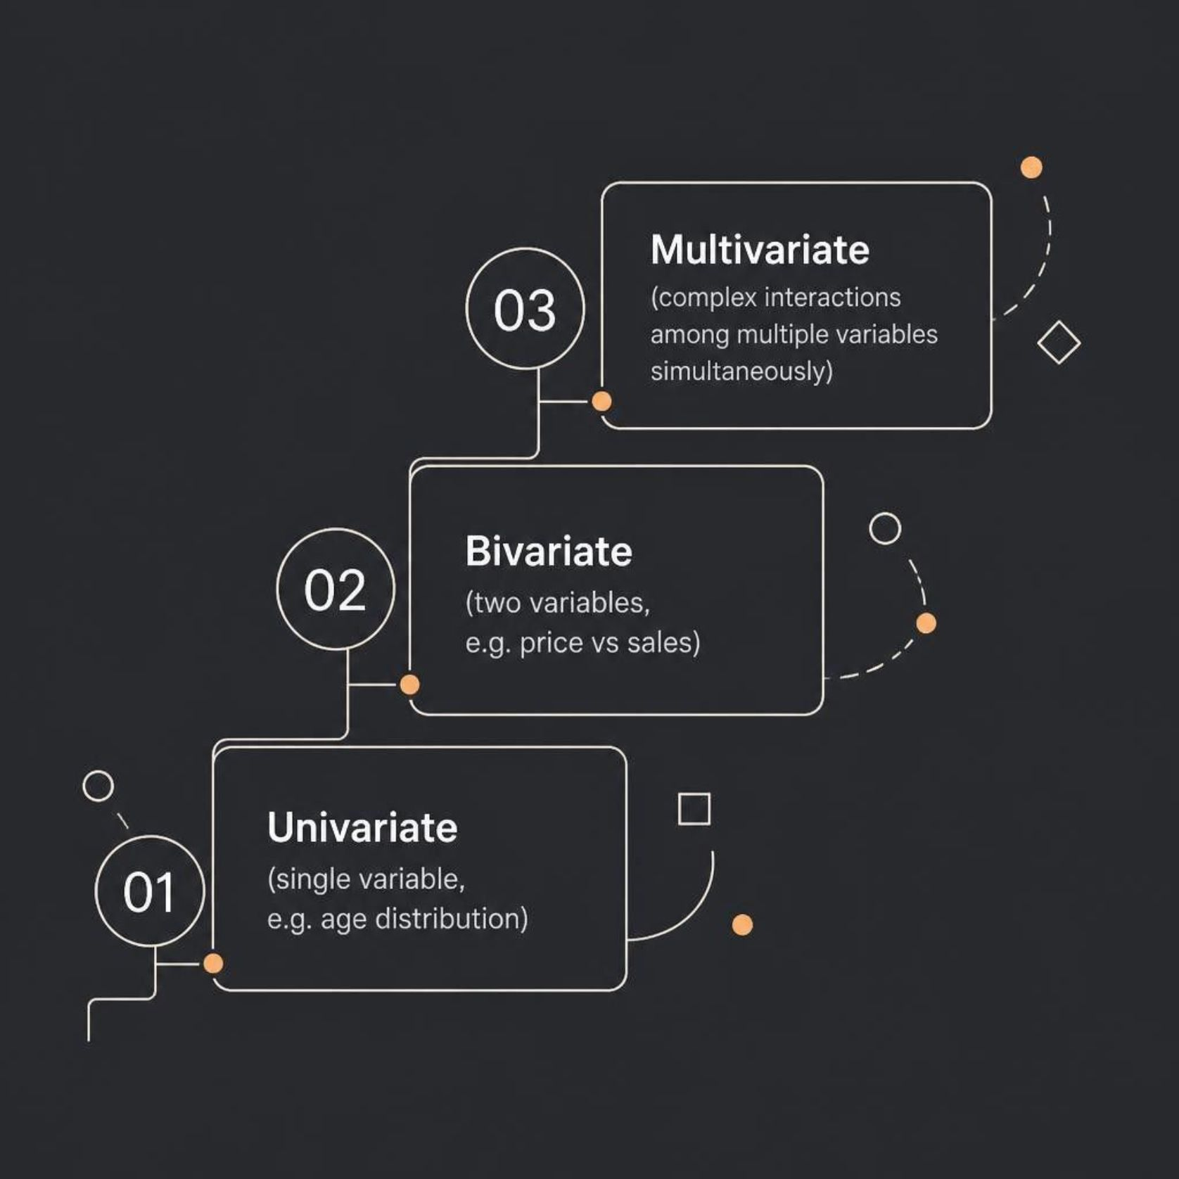
The EDA Taxonomy
Types of analysis — organized by scope and technique.
By Number of Variables
Univariate: Analyzing one variable at a time (e.g., age distribution).
Bivariate: Analyzing relationships between two variables (e.g., price vs. sales).
Multivariate: Analyzing complex interactions among multiple variables.
By Technique
Non-Graphical: Summary metrics — Mean, Median, Standard Deviation.
Graphical: Visual representations — Histograms, Box Plots, Scatter Plots.

Slide 6
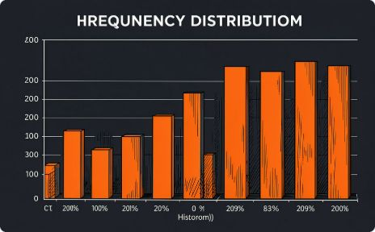
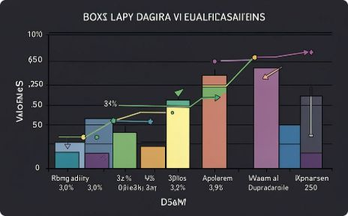
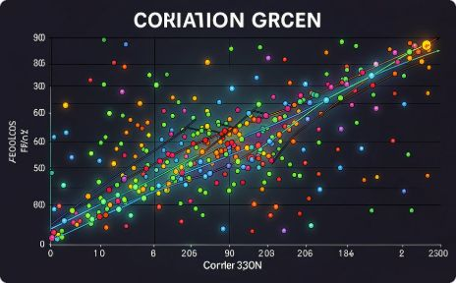
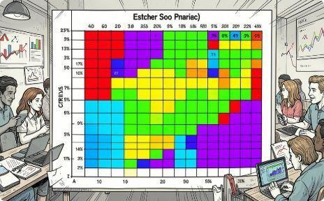
Essential EDA Toolkit & Visualizations
Histograms & Density Plots
Box Plots
Scatter Plots
Heatmaps & Correlation Matrices
Spot outliers, understand data spread, and identify key quartile ranges (IQR).
Examine relationships, trends, and correlations between two numerical variables.
View frequency distributions, identify data patterns, and detect skewness across numerical features.
Evaluate correlation coefficients and relationship strength across all numeric variables simultaneously.

Slide 7

Step-by-Step EDA Pipeline
Health Check
Overview
Univariate
Bivariate
Documentation
Find and handle missing values, duplicates
Inspect counts, types, and samples
Summary stats and single-feature plots
Cross-tabs and relationship plots
Record insights, anomalies, and cleaning needs
A disciplined, repeatable pipeline ensures no critical data quality issue goes undetected before modeling or reporting begins.

Slide 8

Tools Ecosystem
Programming Languages
BI & Data Prep Tools
Python: Pandas, Matplotlib, Seaborn, ydata-profiling.
R: Tidyverse, ggplot2, DataExplorer.
Power Query: Column profile, quality, and distribution views for no-code exploration.
Power BI & Tableau: Interactive visual filtering and outlier exploration for business stakeholders.
Database & SQL
Aggregations (COUNT, AVG, STDDEV) and conditional grouping (GROUP BY) for rapid profiling at scale.

Slide 9
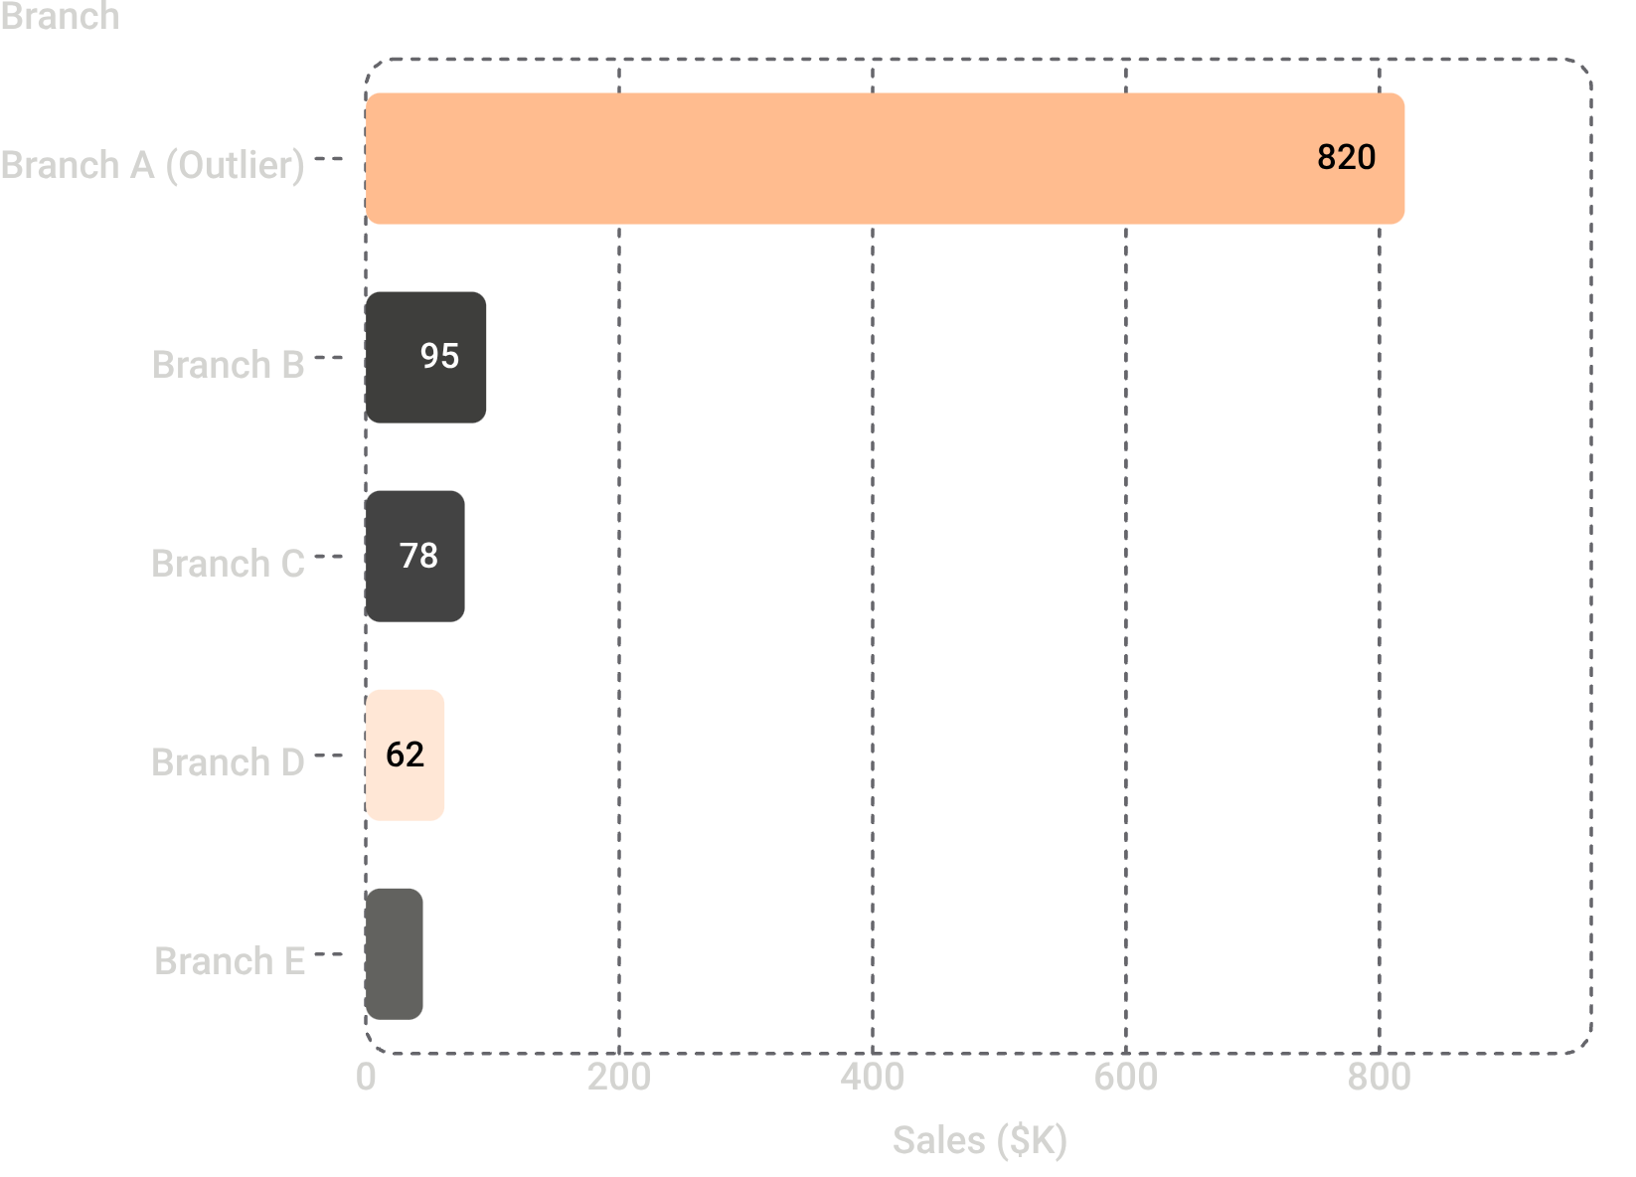

Real-World Impact: A Case Study
Scenario: Evaluating average regional sales performance across multiple branches.
❌ Without EDA
✅ With EDA Discovery
The average sales figure looks strong. The strategy appears successful. Budget is allocated based on a misleading mean.
Box Plot Check reveals a single massive outlier inflated the mean. Segmentation shows 80% of sales came from one branch — others are underperforming.
Business Result: Saved the company from misallocating marketing budgets across underperforming regions.

Slide 10

Conclusion & Key Takeaways
EDA is a Mindset
It is critical thinking combined with statistics and visualization — not just a technical step, but a disciplined way of approaching data.
Prevents Costly Errors
Uncovers anomalies before they ruin machine learning models or business reports — saving time, money, and credibility.
Actionable Outcome
Turns raw, messy data into structured hypotheses and actionable business insights that drive confident decisions.

